Slide 1

Center for the Future of Surgery Accessible 3D Tour
The original Center for the Future of Surgery (CFS) 3D Tour is a three-dimensional virtual walkthrough of the CFS, where users can click buttons to navigate a virtual version of the center. This accessible version contains pictures of the 3D tour and relevant labels. You can access the original 3D tour here. For additional accessibility support, contact bfair@health.ucsd.edu

Slide 2

Tour Navigation
Front screen
Controls
Front Desk
Dollhouse View
OR 1/2
OR 1
OR 2
LL 166
OR 3/4
OR 3
OR 4
LL 177
LL 176
Hybrid OR (slide 1)
Hybrid OR (slide 2)
LL 192 Microsurgery (slide 1)
LL 192 Microsurgery (slide 2)
Overhead View
Front Desk (return)
Space Information
Additional Notes
2

Slide 3

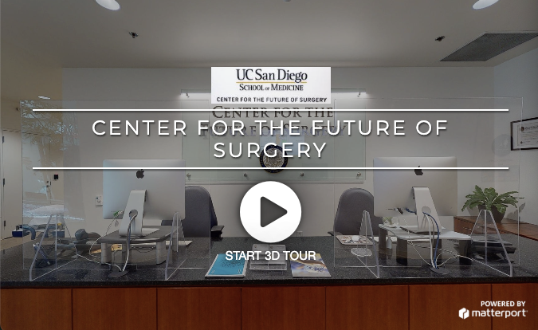

Front Screen
3

Slide 4
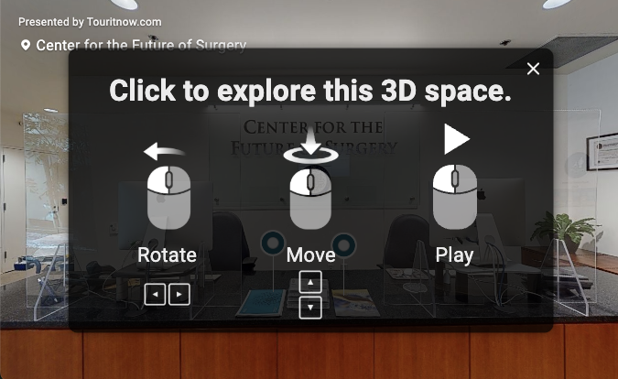
Controls
Mouse click left and right to rotate
Scroll mouse to move up and down
Mouse click left to play

Slide 5
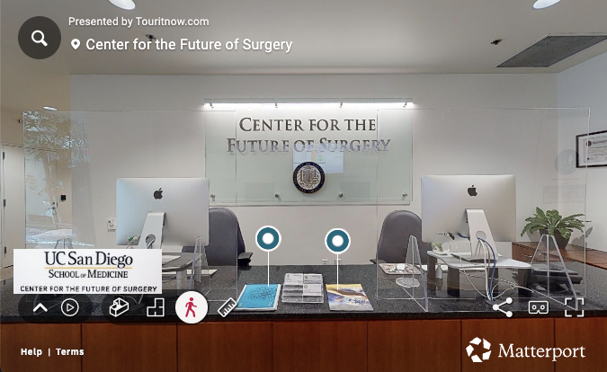
Front Desk
Label left pamphlet: Directory 1/2: Go directly to: OR 1 / OR 2 | LL166 | OR 3 / OR 4 | LL176 | LL177
Label right pamphlet: Directory 2/2: LL 192 Microsurgery | Hybrid OR

Slide 6
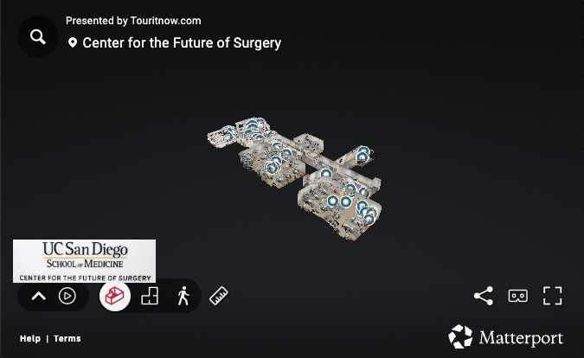
Dollhouse View
3D floor plan of the CFS

Slide 7
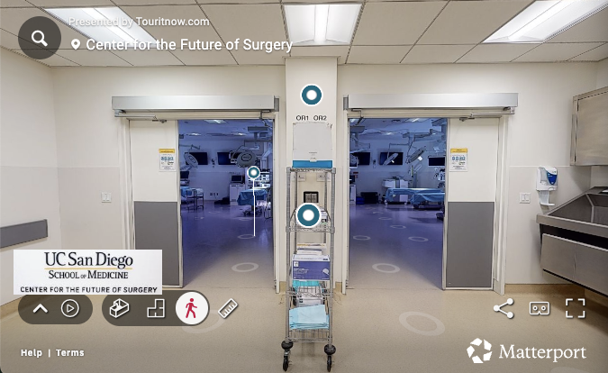
OR 1/2
Label wall: OR 1 & 2: Lead lined for Fluoro labs (c-arm rental), 4 stations each room (light/boom) or 8 combined with center wall lifted (as shown)
Label cart: PPE: Scrubs, PPE, locker rooms provided

Slide 8
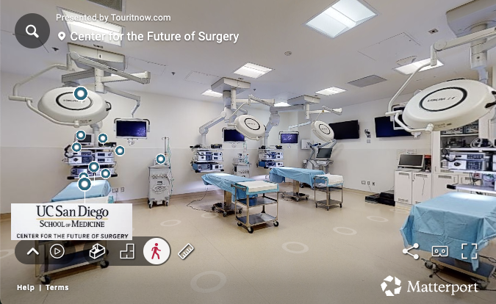
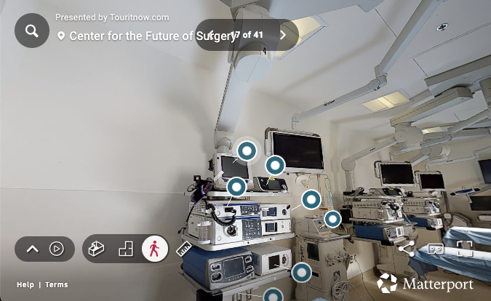
OR 1
Multiple labels:
Instrument table: Mayo stands and large roll carts provided
Standard OR beds: Types vary: radiolucent, multi-directional tilt, removable pads, attachment features etc.
Endoscopic light source with camera system
Vital signs monitor
Energy source
Cautery (electrosurgical generator/bovie)
Suction
Tag 12
Insufflator

Slide 9
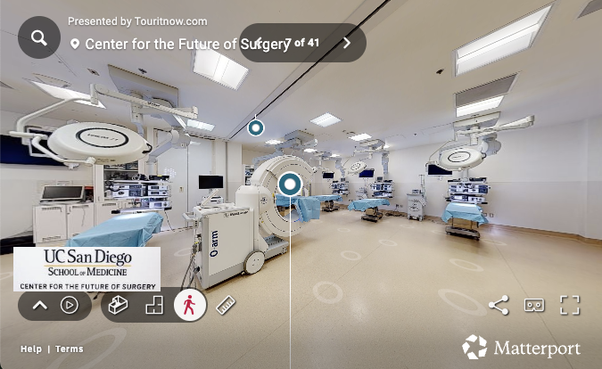
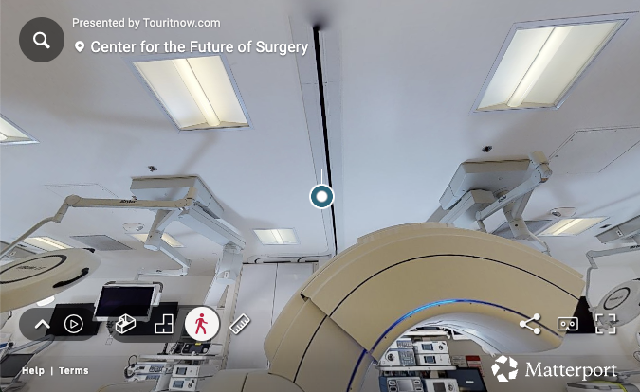
OR 2
Label ground: See room with lights on
Label ceiling: Accordion separation for OR 1 and OR 2

Slide 10
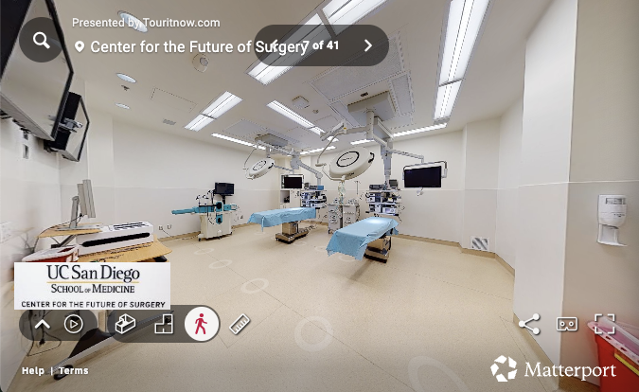
LL 166

Slide 11
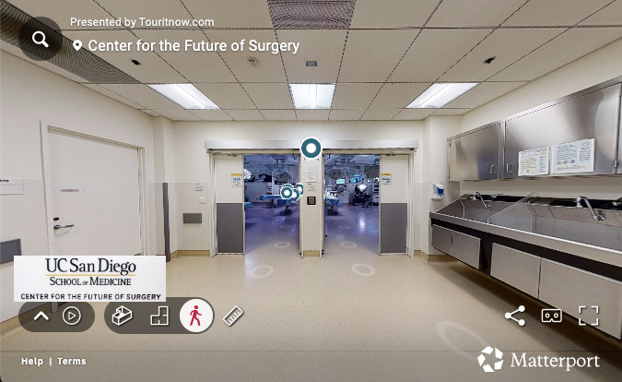
OR 3/4
Label wall: OR 3&4: 6 stations each room (light/boom) or 12 combined with center wall lifted (as shown)

Slide 12
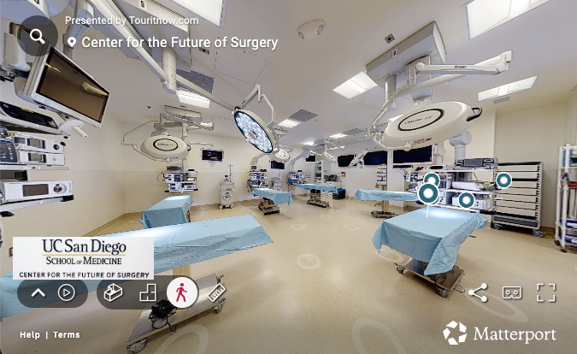
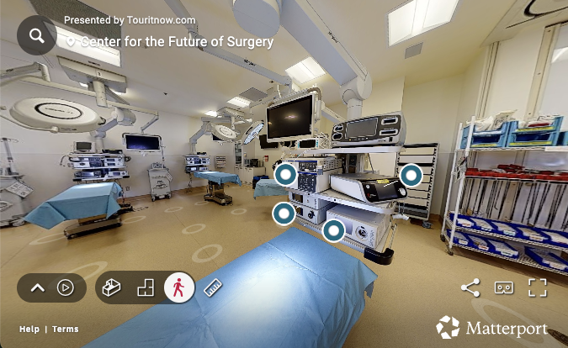
OR 3
Multiple labels:
Standard OR beds: Types vary: radiolucent, multi-directional tilt, removable pads, attachment features etc.
Energy Source
Cautery (electrosurgical generator/bovie)
Insufflator
Endoscopic light source with camera system

Slide 13
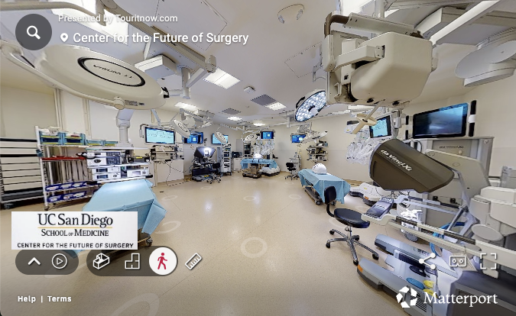
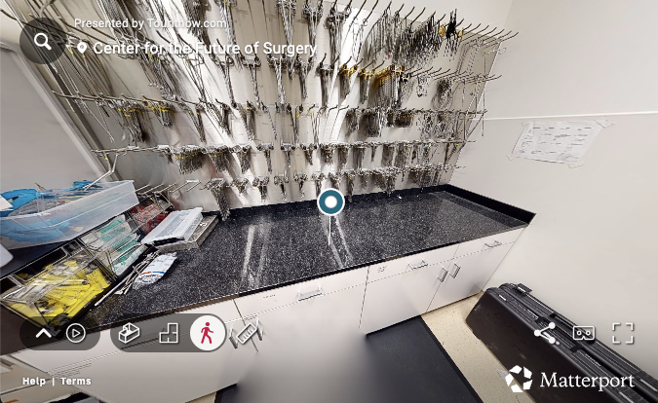
OR 4

Slide 14
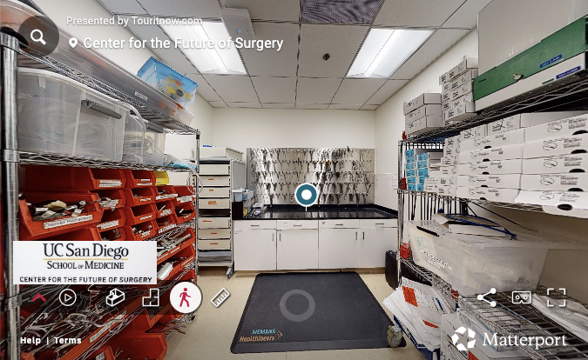
LL 177
Label counter: CFS provided general instrumentation: Consult with CFS Event Coordinator for full listing

Slide 15
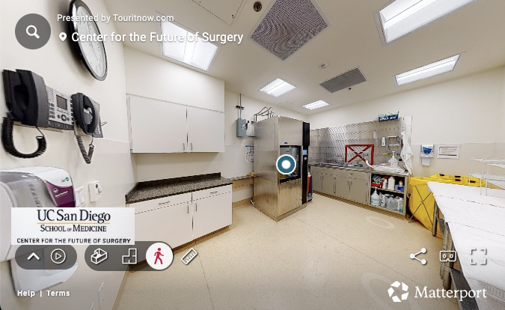
LL 176
Label washing machine: Instrument wash machine: Load sizes vary, CFS techs can wash and ship/save customer instrumentation post lab

Slide 16
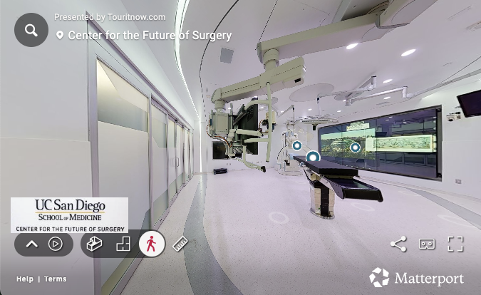
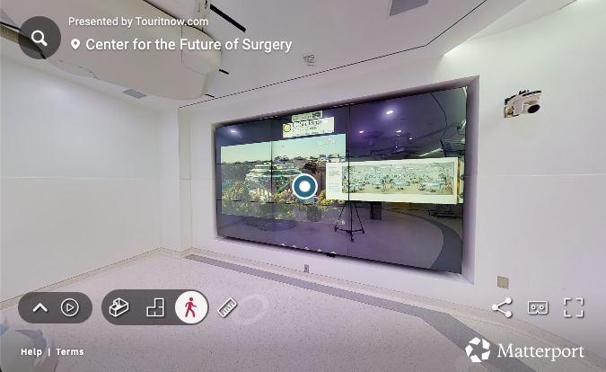
Hybrid OR (slide 1)
Label operating table: Trumpf TruSystem 7500
Label surgical equipment: Stationary C-arm: Siemens Artis Zeego System
Label screen: MultiTaction Screen: Touch screen for interactive media display

Slide 17
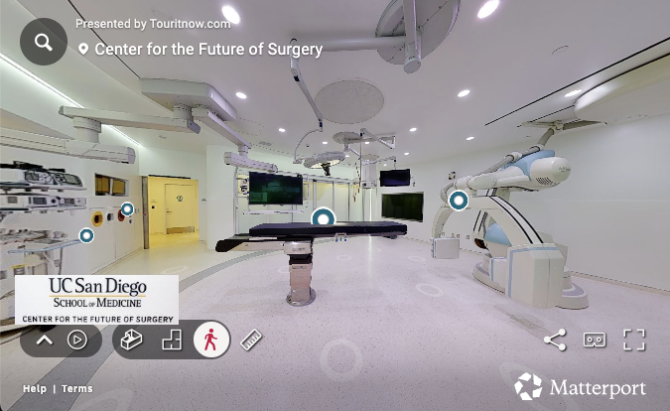
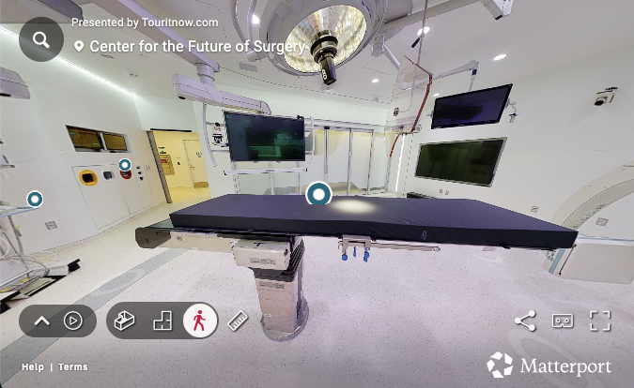
Hybrid OR (slide 2)
Label surgical equipment flat surface: tag 38
Label cabinet: tag 37
Label operating table: Trumpf TruSystem 7500
Label surgical equipment: Stationary C-arm: Siemens Artis Zeego System

Slide 18
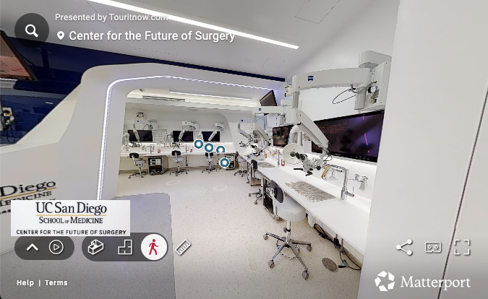
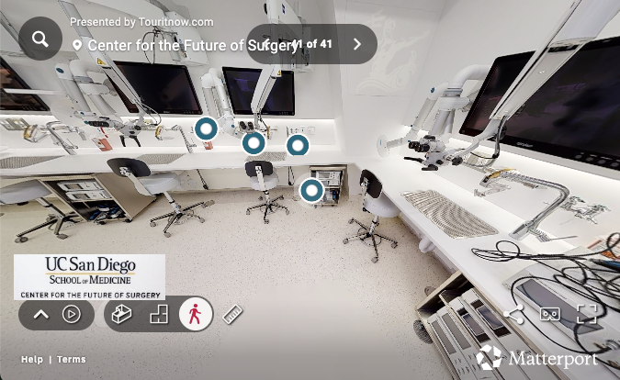
LL 192 Microsurgery (slide 1)
Label surgical equipment: Bone dust vacuum system
Label microscopes: microscopes: Zeiss
Label faucet: instrument wash
Label mini cabinet: light source with camera system

Slide 19
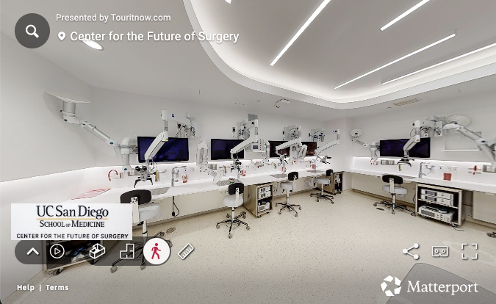
LL 192 Microsurgery (slide 2)

Slide 20
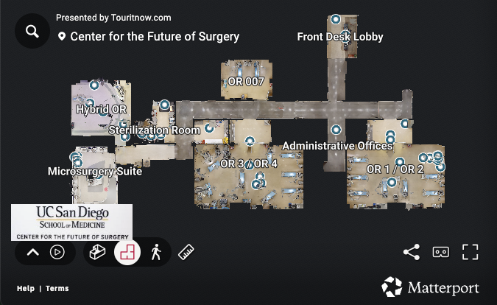
Overhead View
Floor plan of the CFS with labels:
Hybrid OR
Sterilization Room
Microsurgery Suite
OR 007
OR 3 / OR 4
Front Desk Lobby
Administrative Offices
OR 1 / OR 2

Slide 21
Front Desk (return)
Label left pamphlet: Directory 1/2: Go directly to: OR 1 / OR 2 | LL166 | OR 3 / OR 4 | LL176 | LL177
Label right pamphlet: Directory 2/2: LL 192 Microsurgery | Hybrid OR

Slide 22
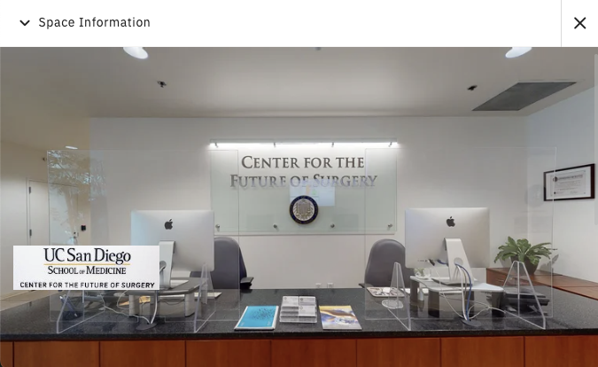
Space Information
Name: Center for the Future of Surgery
Address:
9500 Gilman Dr, La Jolla, CA, 92093, US
Presented by
Touritnow.com

Slide 23
Additional Notes
All views of the CFS in this slideshow are accompanied by the following in the 3D tour:
”Presented by Touritnow.com” test
Search button
“Center for the Future of Surgery” text with location button
UC San Diego School of Medicine Center for the Future of Surgery logo
Buttons to navigate the 3D tour
Buttons for Help (which links to tour controls) and Terms
Matterport logo

Slide 24
Thank you!

